Slide 1
Attention is all you need

Slide 2
Table of contents
Introduction
Sequence to sequence model
Encoder and decoder model
Attention
Architecture of transformer

Slide 3
introduction
RNN, LSTM and gated RNNs are the popularly approaches used for Sequence Modeling tasks such as machine translation and language modeling.
However, RNN/CNN handle sequences word by word in a sequential fashion. This sequentiality is an obstacle toward parallelization of the process. Moreover, when such sequences are too long, the model is prone to forgetting the content of distant positions in sequence
Recent works have achieved significant improvements in computational efficiency and model performance through factorization tricks and conditional computation. But they are not enough to eliminate the fundamental constraint of sequential computation.

Slide 4
introduction
Attention mechanisms are one of the solutions to overcome the problem of model forgetting.
This is because they allow dependency modeling without considering their distance in the input or output sequences.
Due to this feature, they have become an integral part of sequence modeling and transduction models.
However, in most cases attention mechanisms are used in conjunction with a recurrent network

Slide 5
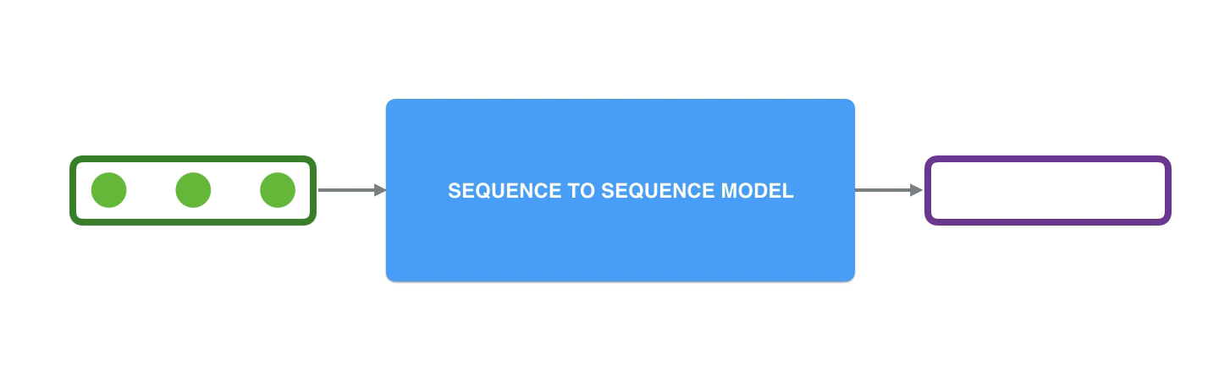
sequence transduction model
Sequence-to-sequence models are deep learning models that have achieved a lot of success in tasks like
Machine translation
Text summarization
Image captioning
A sequence-to-sequence model is a model that takes a sequence of items such as words, letters, features of an images, and outputs another sequence of items.

Slide 6
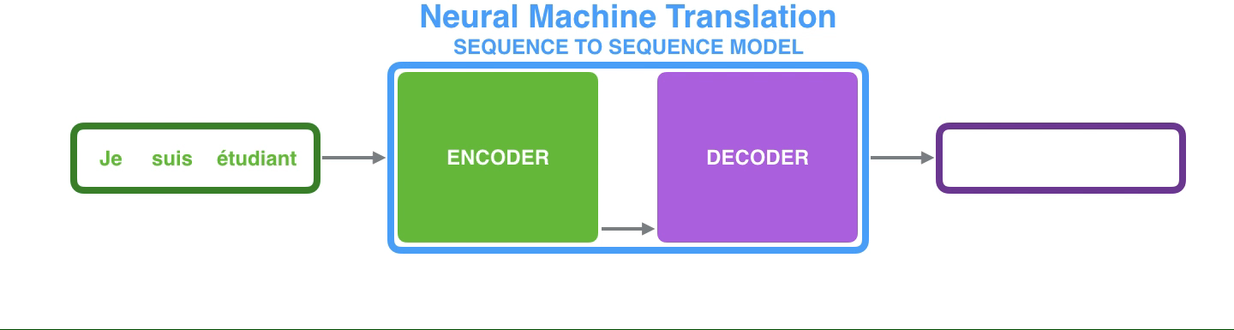
Encoder-decoder model
The encoder processes each item in the input sequence, it complies the information it captures into a vector(called context)
After processing the entire input sequence, the encoder send the context over to the decoder, which begins producing the output sequence item by item

Slide 7
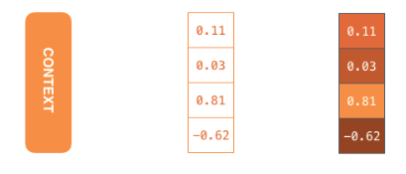
Encoder-decoder model-context
Context is a vector (an array of numbers) in the case of machine translation. The encoder and decoder tend to both be RNN
You can set the size of the context vector when you set up your model. It is basically the number of hidden units in the encoder RNN.
In real world applications the context vector would be of a size like 256, 512, 1024

Slide 8
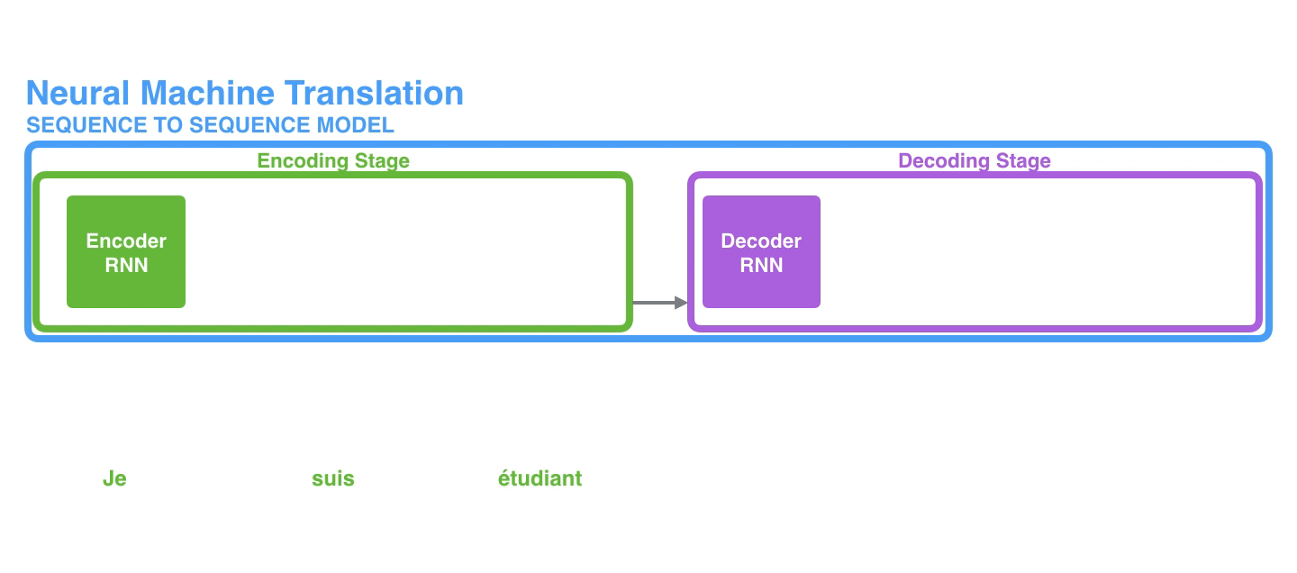
Encoder-decoder model
Since the encoder and decoder are both RNNs, each time step one of the RNNs does some processing, it updates its hidden state based on its inputs and previous inputs it has seen.

Slide 9
Attention model
The context vector turned out to be a bottleneck for these types of models. It made it challenging for the models to deal with long sentences
A technique, Attention, highly improved the quality of machine translation systems. Attention allows the model to focus on the relevant parts of the input sequence as needed
Encoder passes a lot more data to the decoder. Instead of passing the last hidden state of the encoding stage, the encoder passes all the hidden states to the decoder
An attention decoder does an extra step before producing its output. In order to focus on the parts of the input that are relevant to this decoding time step, the decoder does the following:
1. look at the set of encoder hidden states it received
2. Give each hidden states a score
3. Multiply each hidden states by its softmaxed score
Notes:
Attention mechanisms are one of the solutions to overcome the problem of model forgetting.
This is because they allow dependency modeling without considering their distance in the input or output sequences.
Due to this feature, they have become an integral part of sequence modeling and transduction models.
However, in most cases attention mechanisms are used in conjunction with a recurrent network

Slide 10
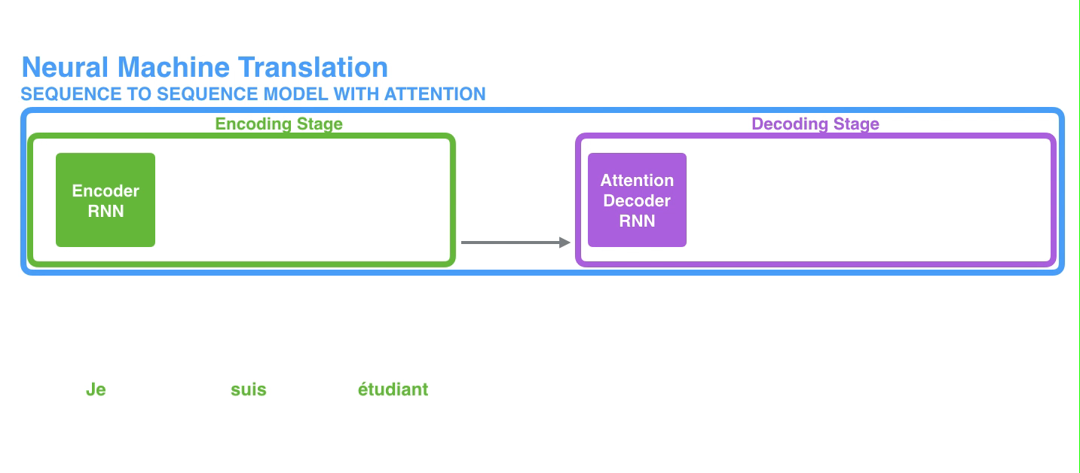
Attention model

Slide 11
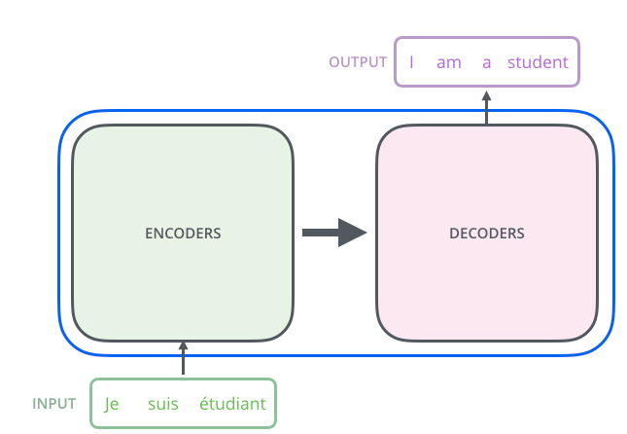
Transformer
Transformer: a model that uses attention to boost the speed with which these models can be trained.
The biggest benefit comes from how the Transformer lends itself to parallelization.
Notes:
Lets begin by looking at the model as a single box and it contain an encoding, decoding component and connections between them
In a machine translation application, it would take a sentence in one language, and output its translation in another

Slide 12
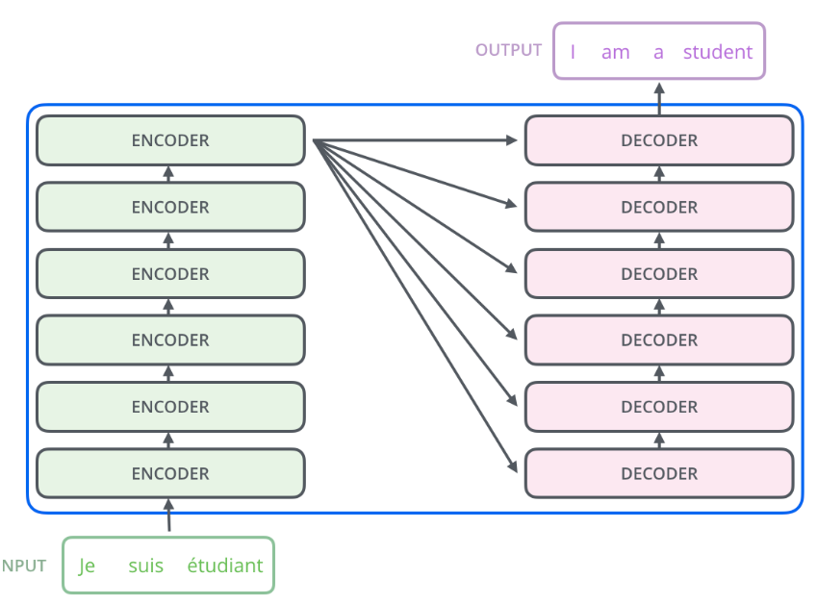
Transformer
The encoding component is a stack of encoders. The decoding component is a stack of decoders of the same number
Notes:
The paper stacks six of them on top of each other,
There is nothing magical about the number six, one can definitely experiment with other arrangements

Slide 13
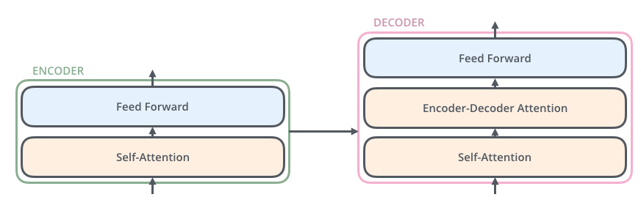
Transformer-encoder
The encoders are all identical in structure. Each on is broken down into two sub-layers
The encoder’s inputs first flow through a self-attention layer- a layer that helps the encoder look at other words in the input sentence as it encodes a specific word
The outputs of the self-attention layer are fed to a feed-forward neural network. The exact same feed-forward network is independently applied to each position
Notes:
The decoder has both those layers but between them is an attention layer that helps the decoder focus on relevant parts of the input sentence
Similar what attention does in sequence to sequence model

Slide 14
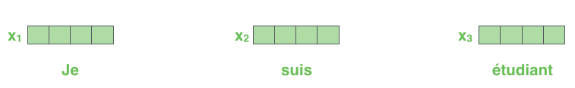
Transformer-encoder
The embedding only happens in the bottom-most encoder. The abstraction that is common to all the encoders is that they receive a list of vectors each of the size 512.
In the bottom encoder that would be the word embedding, but in other encoders, it would be the output of the encoder that is directly below. The size of this list is hyperparameter we can set
Notes:
The hyper parameter basically it would be the length of the longest sentence in our training dataset

Slide 15
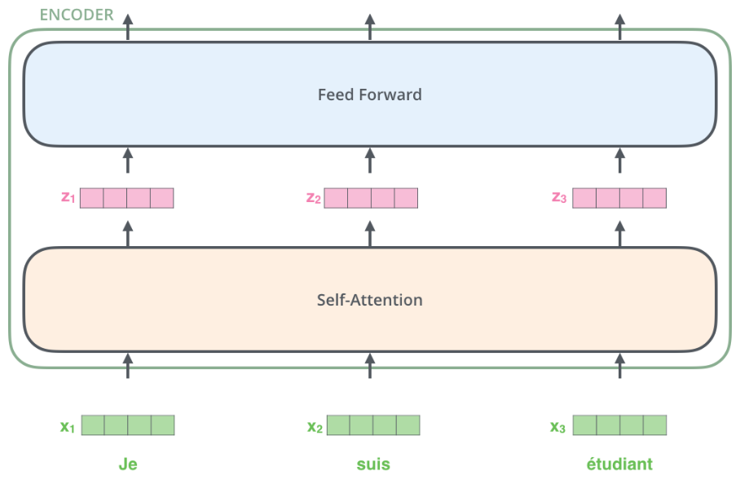
Transformer-encoder
Notes:
Here we begin to see one key property of the transformer, which is that the word in each position flows through its own path in the encoder
There are dependencies between these paths in the self attention layer
However, The feed forward layer does not have those dependencies and thus the various paths can be executed in parallel while flowing through the feed forward layer

Slide 16
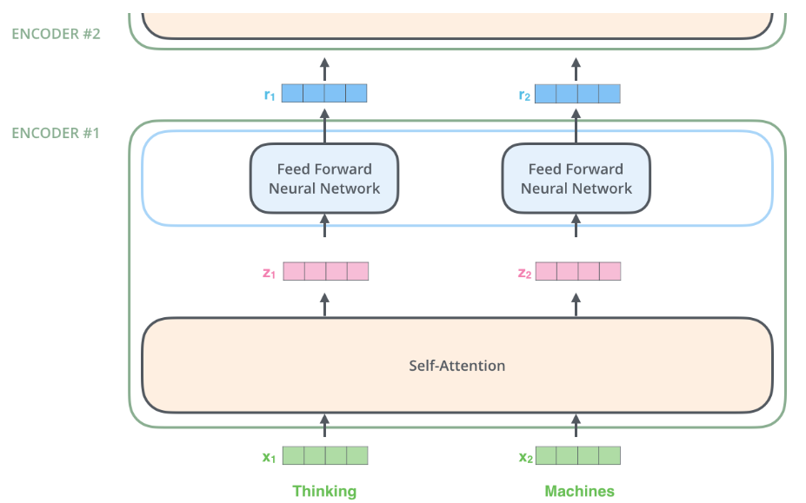
Transformer-encoder
Notes:
We have mentioned already, an encoder receives a list of vectors as input.
It processes this list by passing these vectors into a self-attention layer then into
A feed forward neural network then sends out the output upwards to the next encoder

Slide 17
Transformer-self attention
Say the following sentence is an input sentence we want to translate:
When the model is processing the word “it”, self-attention allows it to associate “it” with “animal”
As the model processes each word (each position in the input sequence), self attention allows it to look at other positions in the input sequence for clues that can help lead to a better encoding for this word

Slide 18
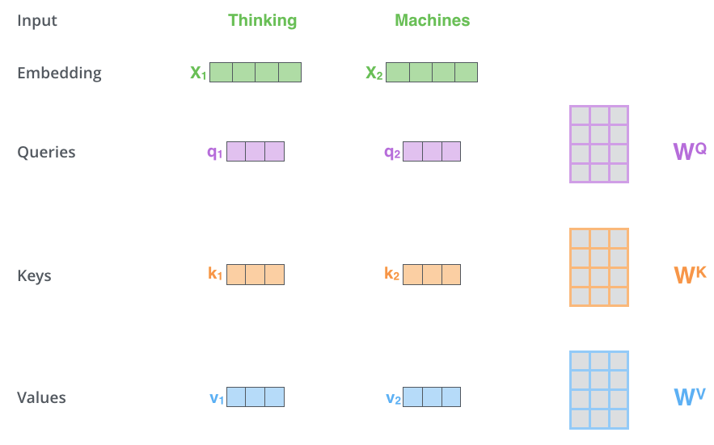
Transformer-self attention
Calculate self-attention using vectors, then proceed to look at how its actually implemented using matrices.
1. Create 3 vectors from each of the encoder’s input vectors. So for each word, we create a Query vector, a Key vector, and a Value vector. These vectors are created by multiplying the embedding by 3 matrices that we trained during the training process.
Notes:
Note that these new vectors are smaller in dimension than the embedding vector. Their dimensionality is 64 while
The embedding and encoder input/output vectors have dimensionality of 512. They don’t have to be smaller, this is an architecture choice to make the computation of multiheaded attention
Query, key, value: for abstractions that are useful calculating and thinking about attention

Slide 19
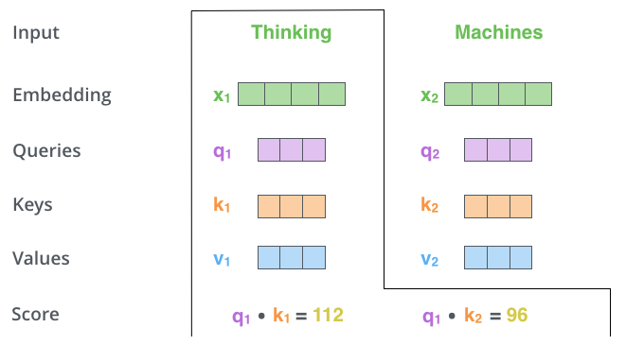
Transformer-self attention
2. Calculate a score. Say we are calculating the self-attention for the first word in this example, “Thinking”. We need to score each word of the input sentence against this word.
The score determines how much focus to place on other parts of the input sentence as we encode a word at a certain position
Notes:
The score is calculated by taking the dot product of the query vector with the key vector of the respective word
We are scoring. SO if we are processing the self-attention for the world in position#1, the first score would be the dot product of q1 and k1
The second score would be the dot product of q1 and k2

Slide 20
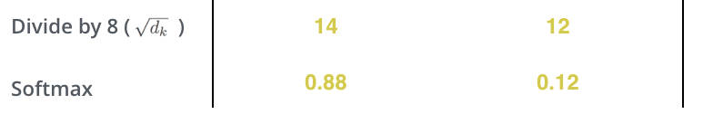
Transformer-self attention
3 and 4 divide the score by 8 then pass the result through a softmax operation. Softmax normalizes the scores so they are all positive and add up to one
Softmax score determines how much how much each word will be expressed at this position. Clearly the word at this position will have the highest softmax score
But sometimes it is useful to attend to another word that is relevant to the current word
Notes:
8: the square root of the dimension of the key vectors used in the paper—64
There could be other possible values but this is the default value in paper

Slide 21
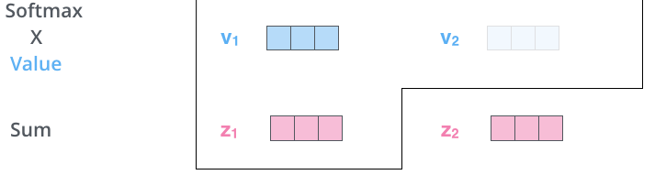
Transformer-self attention
5. Multiply each value vector by the softmax score. The intuition here is to keep intact the values of the words we want to focus on, and drown-out irrelevant words
6. Sum up the weighted value vectors. This produces the output of the self-attention layer at this position
The resulting vector is one we can send along to the feed-forward neural network.

Slide 22
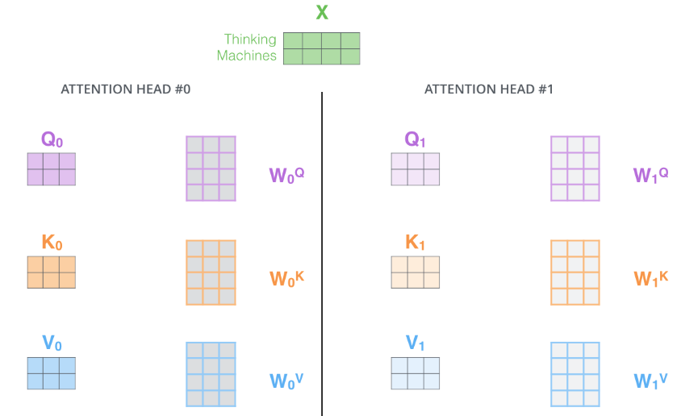
Transformer-multi-head
Multi-headed self attention: improves the performance of the attention layer in two ways
1. Expands the model’s ability to focus on different position. 2. Gives the attention layer multiple representation subspaces. With multi-headed attention we have not only one, but multiple sets of Q/K/V weight matrices. Each of these sets is randomly initialized. Then after training, each set is used to project the input embeddings into a different representation subspaces

Slide 23
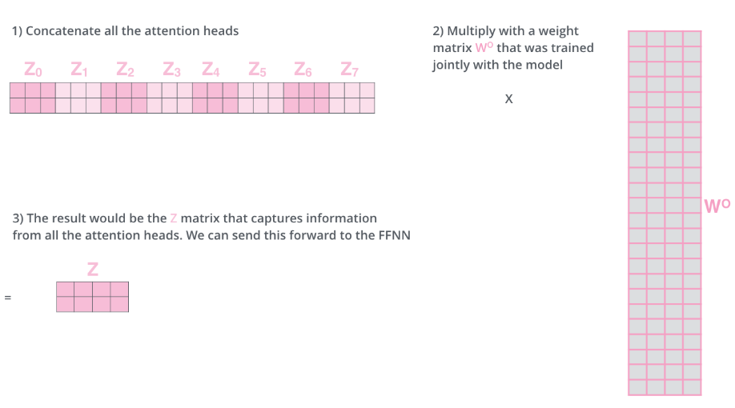
Transformer-multi-head
Notes:
If we do the same self attention calculation we outlined above, just eight different times with different weight matrices,
We end up with eight different z matrices
But The feed forward layer is not expecting eight matrices it is expecting a single matric so we need a way to condense these eight down into a single matrix

Slide 24
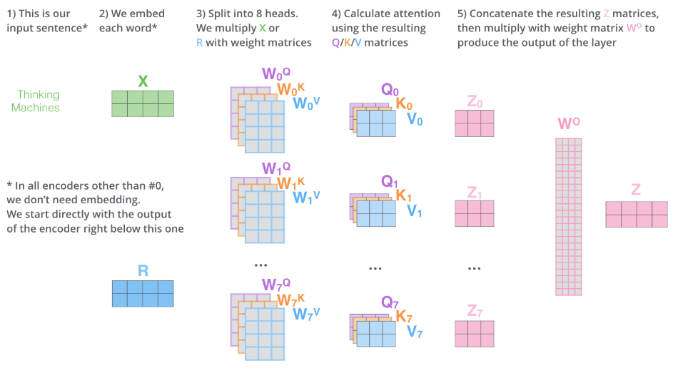
Transformer-multi-head
Notes:
That is pretty much all there is to multihead self attention.
It is quite a handful of matrices

Slide 25
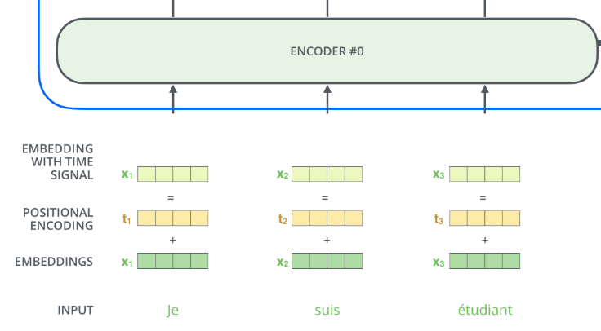
Transformer-positional encoding
The order of the words in the input sequence
To address this, the transformer adds a vector to each input embedding. These vectors follow a specific pattern that the model learns, which helps it determine the position of each word, or the distance between different words in the sequence.
Notes:
The intuition here is that adding these values to the embeddings provides meaningful distances between the embedding vectors once they are projected into Q/K/V vectors and during dot-product attention

Slide 26
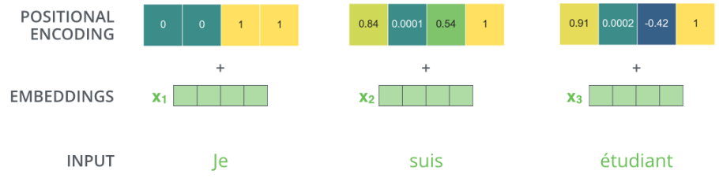
Transformer-positional encoding

Slide 27
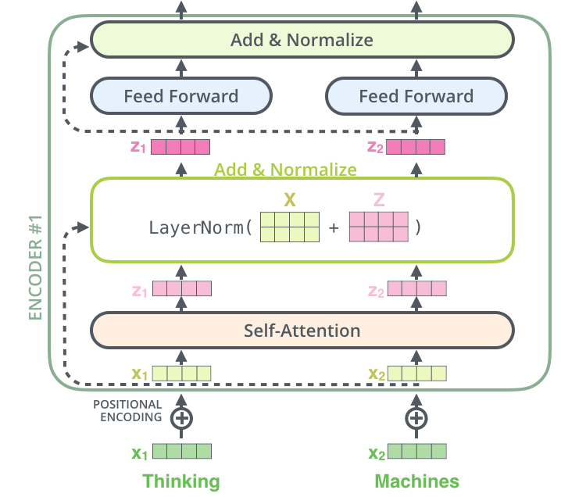
Transformer-residuals
Each encoder has a residual connection around it and is followed by a layer-normalization step

Slide 28
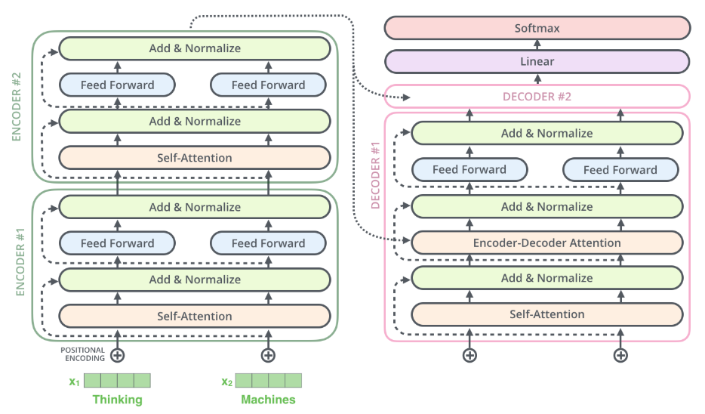
Transformer-residuals
Notes:
If we think transformer of 2 stacked encoders and decoders then it will look like this

Slide 29

Transformer-decoder
Notes:
The following steps repeat the process until a special symbol is reached indicating the transformer decoder has completed its output.
The output of each step is fed to the bottom decoder in the next time step, and the decoders bubble up their decoding results just like the encoders did
And just like we did with the encoder input, we embed and add positional encoding to those decoder inputs to indicate the position of each word

Slide 30

Transformer-decoder
The encoder start by processing the input sequence. The output of the top encoder is then transformed into a set of attention vectors K and V. These are to be used by each decoder in its encoder-decoder attention layer which helps the decoder focus on appropriate places in the input sequence

Slide 31
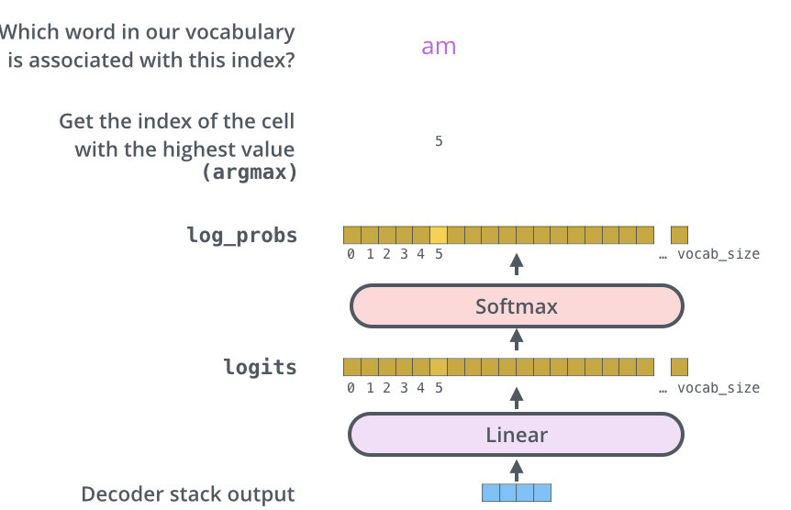
Transformer-linear/softmax
Linear layer is a simple fully connected neural network that projects the vector produced by the stack of decoders, into a much, much larger vector called a logits vector
The softmax layer then turns those scores into probabilities(all positive, all add up to 1) The cell with the highest probability is chosen, and the word associated with it is produced as the output for this time step

Slide 32
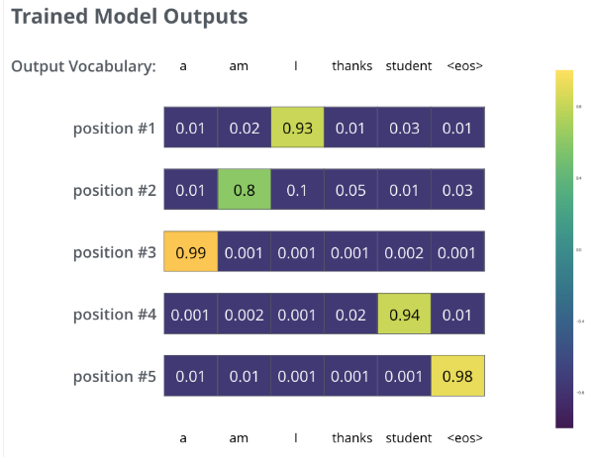
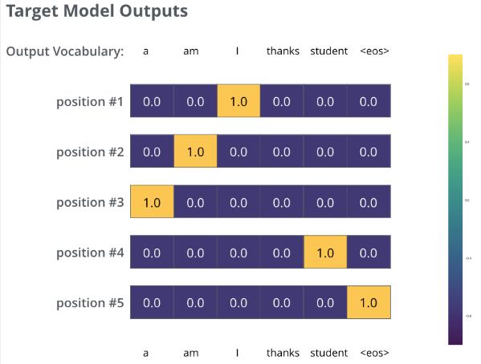
Transformer-training
During training, an untrained model would go through the exact same forward pass. But since we are training it on a label training dataset, we can compare its out with the actual correct output
Goal: we want the output to be a probability distribution indicating the word.
How to do? Subtract one from the other—cross entropy

